Slide 1

Analysing Amazon Sales data

Slide 2
Introduction
Amazon is an American multinational technology company that specializes in e-commerce, cloud computing, digital streaming, and artificial intelligence. It is one of the Biggest e-commerce chain in India.
However management has gained importance to meet increasing competition and the need for improved methods of distribution to reduce cost and to increase profits.

Slide 3
Overview
The dataset contains sales data for various product categories across different regions and countries.
The data includes information such as the region, country, product type, sales channel, order priority, order date, order ID, ship date, units sold, unit price, unit cost, total revenue, total cost, and total profit.
The data spans from 2010 to 2017, covering a 7-year period.

Slide 4
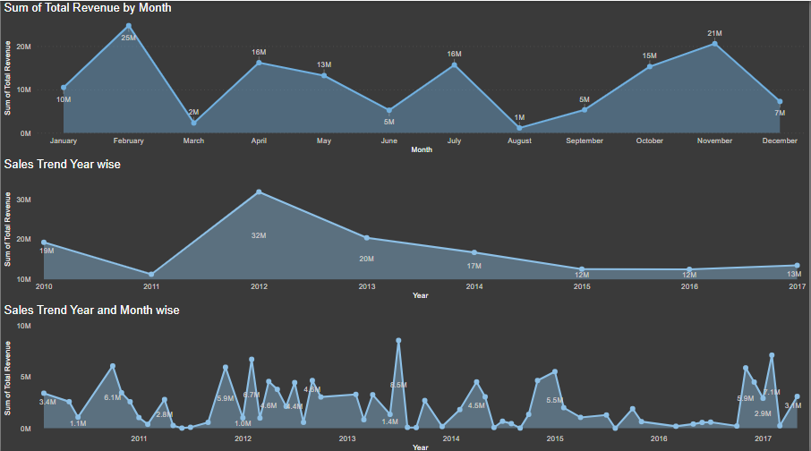
February, November, April and July are the Strongest month in terms of Sales.
2012 is the Best Year for Sales but since then there is downward trend.
In the yearly month wise sales we can also see the downward trend since 2012, however there are the specific month where sales jump up.

Slide 5

Regional Breakdown
6 Major regions
Highest Revenue
Highest Profit
Europe
Asia
Central America
Australia and Oceania
Middle East and North Africa
Sub-Saharan Africa
Sub-Saharan Africa 28.2 M
Europe 12.4 M

Slide 6
Top Performing Countries
Revenue
Profit
Honduras($5.99M)
Switzerland($3.78M)
Russia($1.15M)
Honduras($1.48M)
Switzerland($1.50M)
Myanmar($1.36M)

Slide 7
Product Performance
Best Selling product
Cosmetics
83,718 Unit Sold
$36.6M in Total Revenue
Most Profitable(%) Product
Clothes
71,260 Unit Sold
Least Profitable Product
Fruits
49,998 Unit Sold
$14.5M in Total Profit
$7.7M in Total Revenue
$5.2M in Total Profit
$466K in Total Revenue
$120K in Total Profit

Slide 8
Sales Channels
Offline
Unit Sold 2,76,782 (54%)
Total Revenue 79M (58%)
Total Profit 24.9M (56%)
Online
Unit Sold 2,36,089 (46%)
Total Revenue 58.2M (42%)
Total Profit 19.2M (44%)

Slide 9
Order Priorities
Highest
High Priority order accounted the Highest Revenue of 48.7M
High Priority order accounted the Highest Profit of 16.8M
Lowest
Casual Priority order accounted the Lowest Revenue of 18.8M
Casual Priority order accounted the Lowest Profit of 6.7M

Slide 10
Recommendations
Focus on expanding sales in the top-performing regions, such as Sub-Saharan Africa and Europe.
Prioritize the development and marketing of Cosmetics and Clothes product categories, as they have shown the highest revenue and profitability.
Investigate the reasons behind the relatively low profitability of the Fruits category and consider ways to improve its performance.
Analyze the differences in performance between the Offline and Online sales channels to identify opportunities for optimization and growth.
Allocate more resources towards fulfilling high-priority orders, as they have demonstrated the highest revenue and profit potential.

Slide 11
Thank you

